Slide 1
Credit Card Approval
APR GROUP

Slide 2
AGENDA
Overview
​Tasks
Model
​Final Thoughts
ETL
Flask
Team Members

Slide 3

Overview
Credit card debt has recently surged in the United States as Americans borrowed billions of dollars to continue spending in the face of growing inflation. Credit card balances increased $46 billion in the second quarter, a 5.5 percent increase from the first quarter, and there was also an uptick in new credit card accounts. The 13 percent increase from the second quarter of 2021 to the second quarter of 2022 was the biggest such jump in more than 20 years. Americans are borrowing more which primarily can be attributable to higher prices.
The most used method to manage risk is credit score. It generally takes personal information along with other applicant data to predict potential defaults and borrowings. In this project, our goal was to build a credit card approval predictor.

Slide 4
Overview: Data
2 Datasets
Application Records Credit Records

Slide 5
A rise in new credit card accounts in the second quarter — 233 million — marked a high not seen since 2008.
“
”
Federal Reserve Bank of New York

Slide 6





TASKS
ETL
ETL
ETL
MODEL
FLASK
Importing and loading the dataset.
Manipulating the data
Pre-processing the data
Fitting a Model to the training set
Evaluating the performance of the model

Slide 7



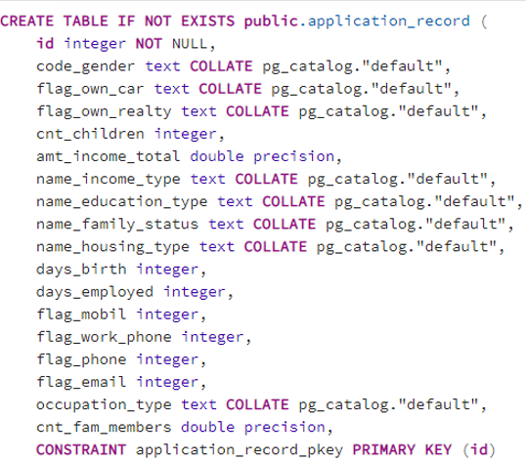
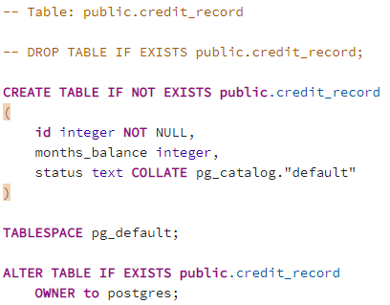



ETL

Slide 8
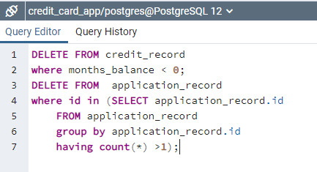
ETL

Slide 9
MODEL
Logistic Regression
Decision Tree
Random Forest

Slide 10
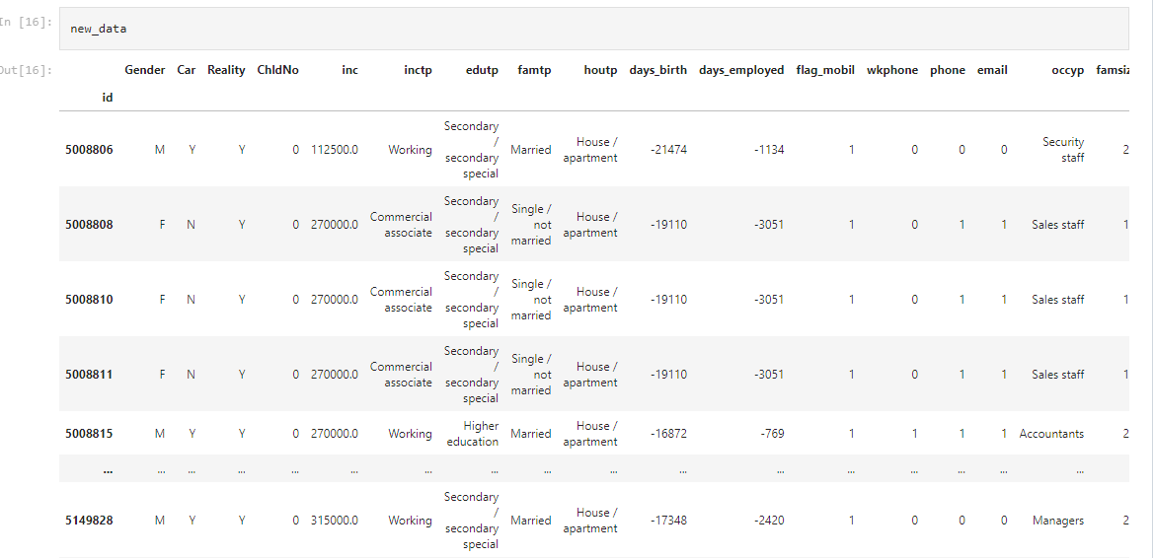
MODEL

Slide 11
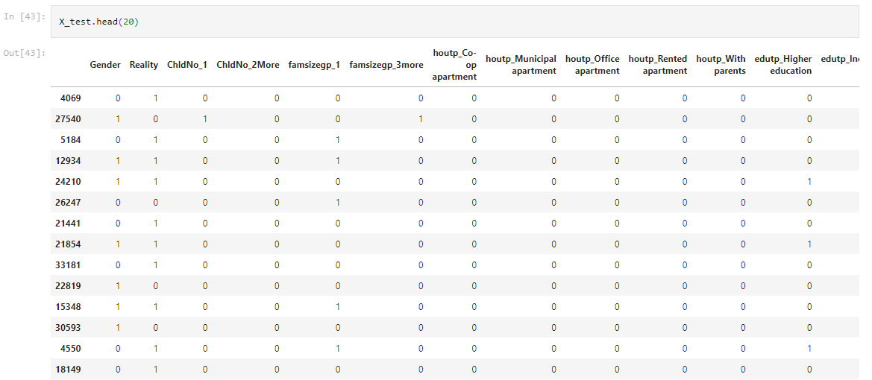
MODEL

Slide 12



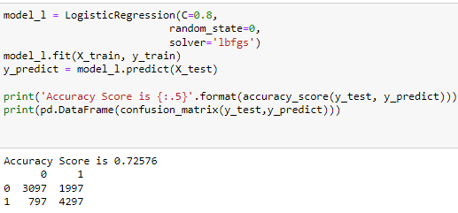
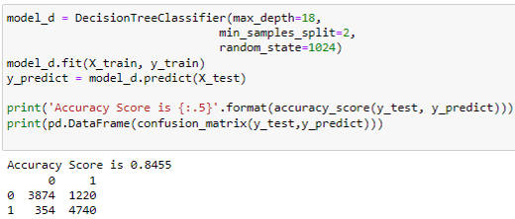
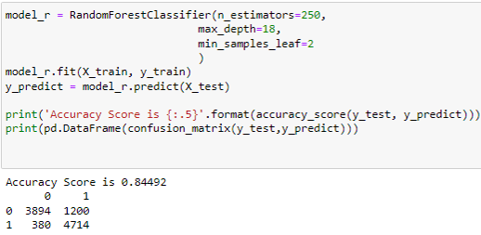
HOW WE GET THERE
Logistic regression
Decision tree classifier
Random forest classifier
Accuracy Score is 73%
Accuracy Score is 85%
Accuracy Score is 85%

Slide 13
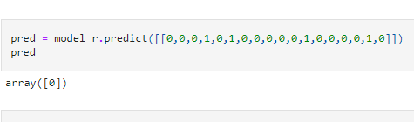
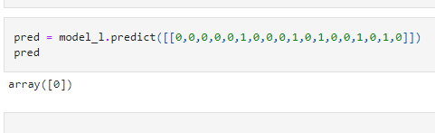
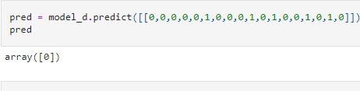
HOW WE GET THERE
Logistic regression
Decision tree classifier
Random forest classifier
Accuracy Score is 73%
Accuracy Score is 85%
Accuracy Score is 85%

Slide 14
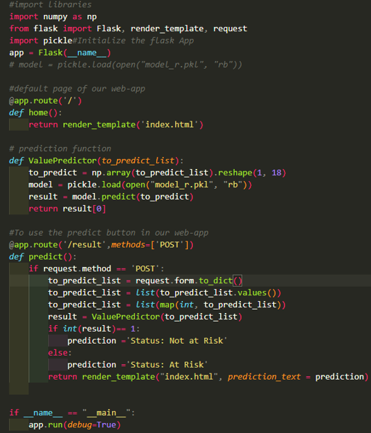
FLASK

Slide 15
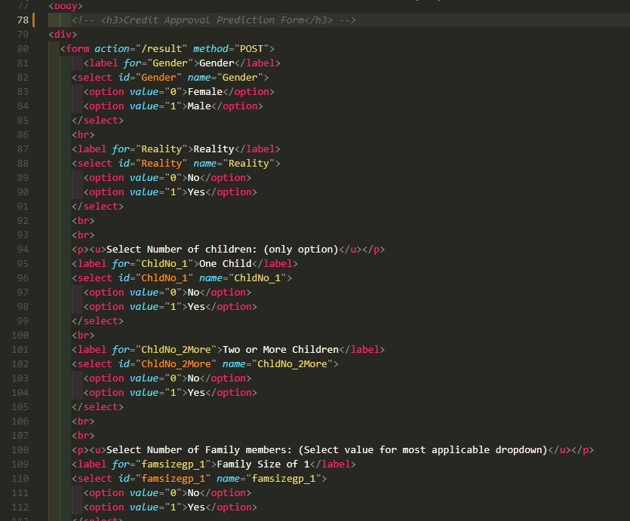
FLASK

Slide 16
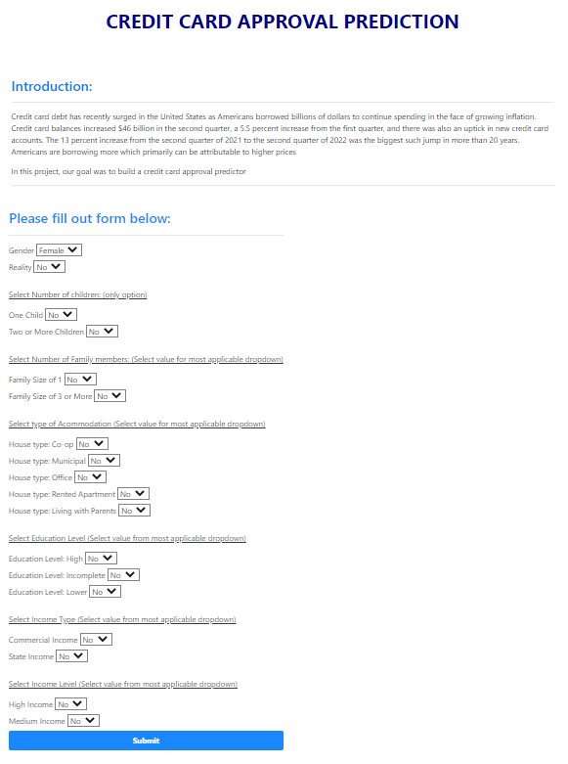
FINAL THOUGHTS
There were a few steps that were necessary. There were also some interesting discoveries within the data as well. A machine learning model was developed to predict whether a person’s application for a credit card would get approved or not based on information about that person.

Slide 17
The increased credit card applications and subsequent debt reflects consumers’ struggles to keep up with inflation. Stubbornly high prices on groceries, gasoline and other basic needs have changed how Americans spend their money.
“
”

Slide 18




MEET OUR TEAM
Sravitha MatLAPUDI
TRUTH PRICE
Jeff Frazier​
KHANH LE​
ETL, Code Research, Code Build, Modeling
ETL, Code Research, Code Build, Modeling
Visuals, Presentation Build , Data Research
ETL, Code Research, Code Build, Modeling

Slide 19

Questions? THANK YOU

